Slide 1


VALDIG General Assembly, digital meeting, Thursday 16th September, 2021,
17.00-19.00 CET,
http://www.valdig.eu

Slide 2
AGENDA
Welcome and introduction (Andrea De Gottardi)
Steering committee composition (Andrea De Gottardi)
Finances (Pierre-Emmanuel Rautou)
Update preparatory work for BAVENO VII (Pierre-Emmanuel Rautou)
VALDIG publications
Updates about ongoing/planned studies
VALDIG-ERN activities (Aurélie Plessier)
VALDIG training activities and collaboration with EASL (Filipe Nery)
Questions
Closing remarks (Andrea De Gottardi)

Slide 3
Current steering committee composition
- Andrea De Gottardi (chair, until 2021) ➔ to be replaced
- Pierre Emmanuel Rautou (secretary until 2021, then chair)
- Virginia Hernandez-Gea (vice-secretary until 2021, then secretary)
- Marco Senzolo until 2021 (new vice-secretary)
- Akash Sukla until 2021 (ready to renew for 2 years - will take over the content management of www.valdig.eu)
- Sarwa Murad until 2021 (ready to renew for 2 years )
- Valérie Paradis until 2022 (ev +2)
- Laure Elkrief until 2022 (ev +2)
- Filipe Nery until 2022 (ev +2)
- Aurélie Plessier (ERN liaison)
NEW APPLICATIONS TO BECOME MEMBER OF THE VALDIG SC:
Pierre Deltenre
Xingshun Qi
Angela Puente Sanchez
Laura Turco
Michael Praktiknjo
Giulia Tosetti
Henning Grønbæk
2021: VALDIG members confirmed

Slide 4
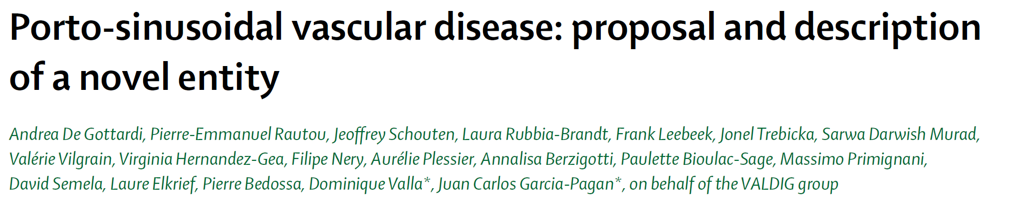
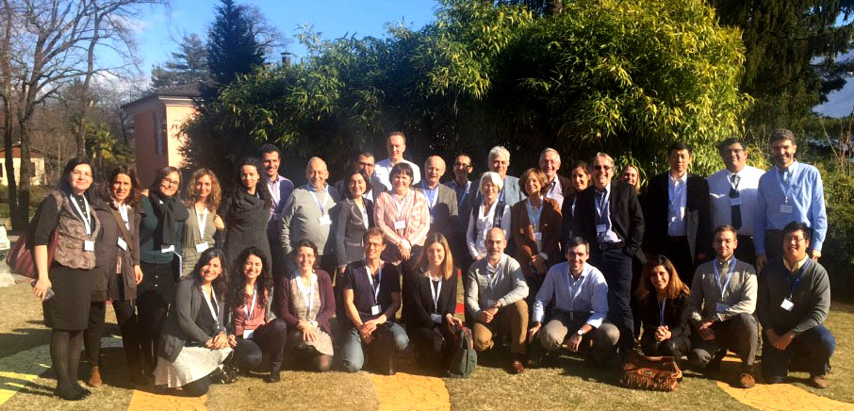

Slide 5
AGENDA
Welcome and introduction (Andrea De Gottardi)
Steering committee composition (Andrea De Gottardi)
Finances (Pierre-Emmanuel Rautou)
Update preparatory work for BAVENO VII (Pierre-Emmanuel Rautou)
VALDIG publications
Updates about ongoing/planned studies
VALDIG-ERN activities (Aurélie Plessier)
VALDIG training activities and collaboration with EASL (Filipe Nery)
Questions
Closing remarks (Andrea De Gottardi)

Slide 6
VALDIG finances
2021: no expense no revenue
➔ Remaining: 29 825.81 €

Slide 7
AGENDA
Welcome and introduction (Andrea De Gottardi)
Steering committee composition (Andrea De Gottardi)
Finances (Pierre-Emmanuel Rautou)
Update preparatory work for BAVENO VII (Pierre-Emmanuel Rautou)
VALDIG publications
Updates about ongoing/planned studies
VALDIG-ERN activities (Aurélie Plessier)
VALDIG training activities and collaboration with EASL (Filipe Nery)
Questions
Closing remarks (Andrea De Gottardi)

Slide 8
Timeline
27.08.2021 | Zoom meeting for discussion of sections identified as needing discussion
16.09.2021 | New PSDV discussion
01.10.2021 | Powerpoint presentations from each panel with relevant background and “final” statements to be discussed in the pre-meeting
15 and 16.10.2021 | Faculty pre-meeting (zoom)
27 to 31.10.2021 | Baveno Meeting (EASL platform)
31.10.2021 | Deadline book chapter

Slide 9
AGENDA
Welcome and introduction (Andrea De Gottardi)
Steering committee composition (Andrea De Gottardi)
Finances (Pierre-Emmanuel Rautou)
Update preparatory work for BAVENO VII (Pierre-Emmanuel Rautou)
VALDIG publications
Updates about ongoing/planned studies
VALDIG-ERN activities (Aurélie Plessier)
VALDIG training activities and collaboration with EASL (Filipe Nery)
Questions
Closing remarks (Andrea De Gottardi)
VALDIG book!!
EASL CPG on coagulation
EASL monothematics

Slide 10
AGENDA
Welcome and introduction (Andrea De Gottardi)
Steering committee composition (Andrea De Gottardi)
Finances (Pierre-Emmanuel Rautou)
Update preparatory work for BAVENO VII (Pierre-Emmanuel Rautou)
VALDIG publications
Updates about ongoing/planned studies
VALDIG-ERN activities (Aurélie Plessier)
VALDIG training activities and collaboration with EASL (Filipe Nery)
Questions
Closing remarks (Andrea De Gottardi)

Slide 11
Splanchnic vein thrombosis and/or Budd-Chiari Syndrome after SARS-COV-2 vaccination
Main objective
To investigate the incidence of SVT or BCS after SARS-COV2 vaccination and describe 1) clinical presentation, 2) diagnostic work-up, 3) use of recanalization procedures, 4) portal hypertensive complications or liver failure, 6) choice of anticoagulant treatment, and 7) outcome
Inclusion criteria
Radiologically confirmed new diagnosis of SVT or BCS in adults (age>18)
Onset of symptoms within 4 weeks after COVID-19 vaccine (any type, first or second administration)
Exclusion Criteria
Known solid organ malignancy within the last year
Patients with liver cirrhosis
NOTE: even those not fulfilling criteria of VIIT but fulfilling inclusion criteria will be included

Slide 12
Study design and update
Study Design
1. Casefinding through VALDIG network , retrospective data collection through study CRF
2. Casefinding through the EudraVigilance database of the European Medicines Agency (EMA) by requesting patient level data on resported cases
3. Comparison with known cases of SVT / BCS before COVID19 era (VALDIG data/ ENVIE data)
Definition Vaccine induced thrombocytopenia and thrombosis (VIIT):
D+4 and D+28 following COVID-19 vaccination + acute thrombosis + platelets <150x109/l + positive HIT ELISA test (OR D-Dimer > 4x ULN in case HIT ELISA is not available)
Update
2 reported cases from Spain; 2 cases from the NL; 4-5 cases from the UK
1 case In France?
Request EMA data ongoing

Slide 13

“PSVD Natural history and liver transplantation”
1) FIRST STUDY: to depict the natural history and outcome in a large multicentre cohort of patients with PSVD with portal hypertension diagnosed and followed-up in tertiary European Hospitals. In addition, to identify prognostic factors and long-term outcome in these patients, as well as to determine the clinical impact of the underlying disease in prognosis.
2) SECOND STUDY: The main goal of this study was to evaluate the characteristics of PSVD patients receiving LT and their long-term outcome (including data on survival and potential recurrence of the disease

Slide 14
PSVD Natural history
N= 625
N= 38 Excluded
-15 Not adequate biopsy
13 Too many missing data in the CRF
10 Pediatric age less than 14 years
N= 587

Slide 15
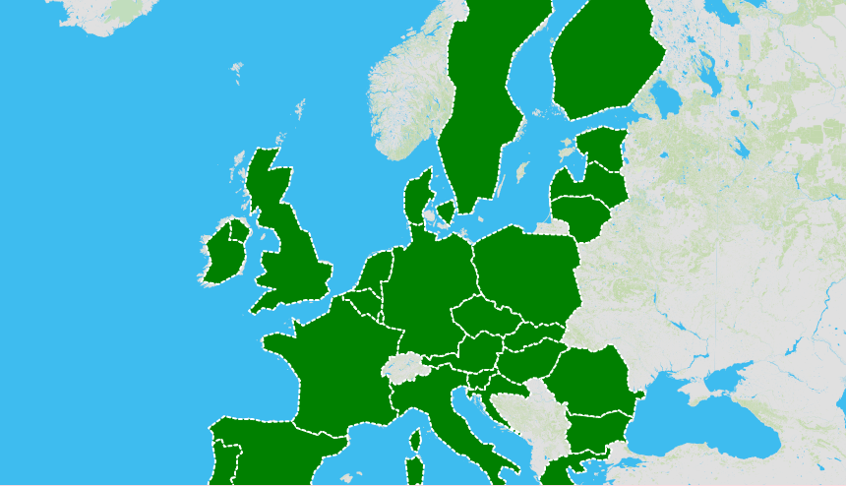
Hospital Clínic, Barcelona.
Ramón y Cajal, Madrid.
Sant Pau, Barcelona.
Gregorio Marañón, Madrid.
Puerta de Hierro, Madrid.
H.Valdecilla, Santander.
H.Canrruti, Barcelona
H.La Fe, Valencia.
H.Universitario Oviedo
H.Universitario Toledo.
H.Vall d´Hebron, Barcelona.
Hospital Universitario de Canarias.
Clichy Hospital
Birmingham´s Hospital
Modena´s Hospital
Roma´s Hospital
Toulousse´s Hospital
Leuven´s Hospital
Milan´s Hospital
Berna´s Hospital
Cluj-Napoca´s Hospital
Bohn´s Hospital
Ghent´s Hospital
Porto´s Hospital
Geneva´s Hospital
Viena´s Hospital
Gujrat Valsad´s Hospital
Lisboa´s Hospital
28 participing centres!
Writting manuscript

Slide 16
PSVD and LT
N= 900 Explanted
livers Center A
N= 1135 Explanted
livers Center B
N= 1231 Explanted
livers Center C
N= 1056 Explanted
livers Center D
N= 625
-N= 38 Excluded
-15 Not adequate biopsy
13 Too many missing data
in the CRF
10 Pediatric age less than 14 years
0 explanted
livers
reclassified
as PSVD
4 explanted
livers
reclassified
as PSVD
5 explanted
livers
reclassified
as PSVD
20 explanted
livers
reclassified
as PSVD
N= 29
N= 50 received LT
Writting manuscript
N= 79

Slide 17
“PSVD and hormones”
Aim
Evaluate the impact of female hormones in PSVD onset/progression
Objectives
Evaluate the association between PSVD onset and menopausal state
Evaluate the frequency of hormone therapy in women with PSVD, both in pre and postmenopausal women
Determine the impact of hormone therapy in the severity of PSV
Inclusion Criteria
-Women in natural history (same criteria)

Slide 18
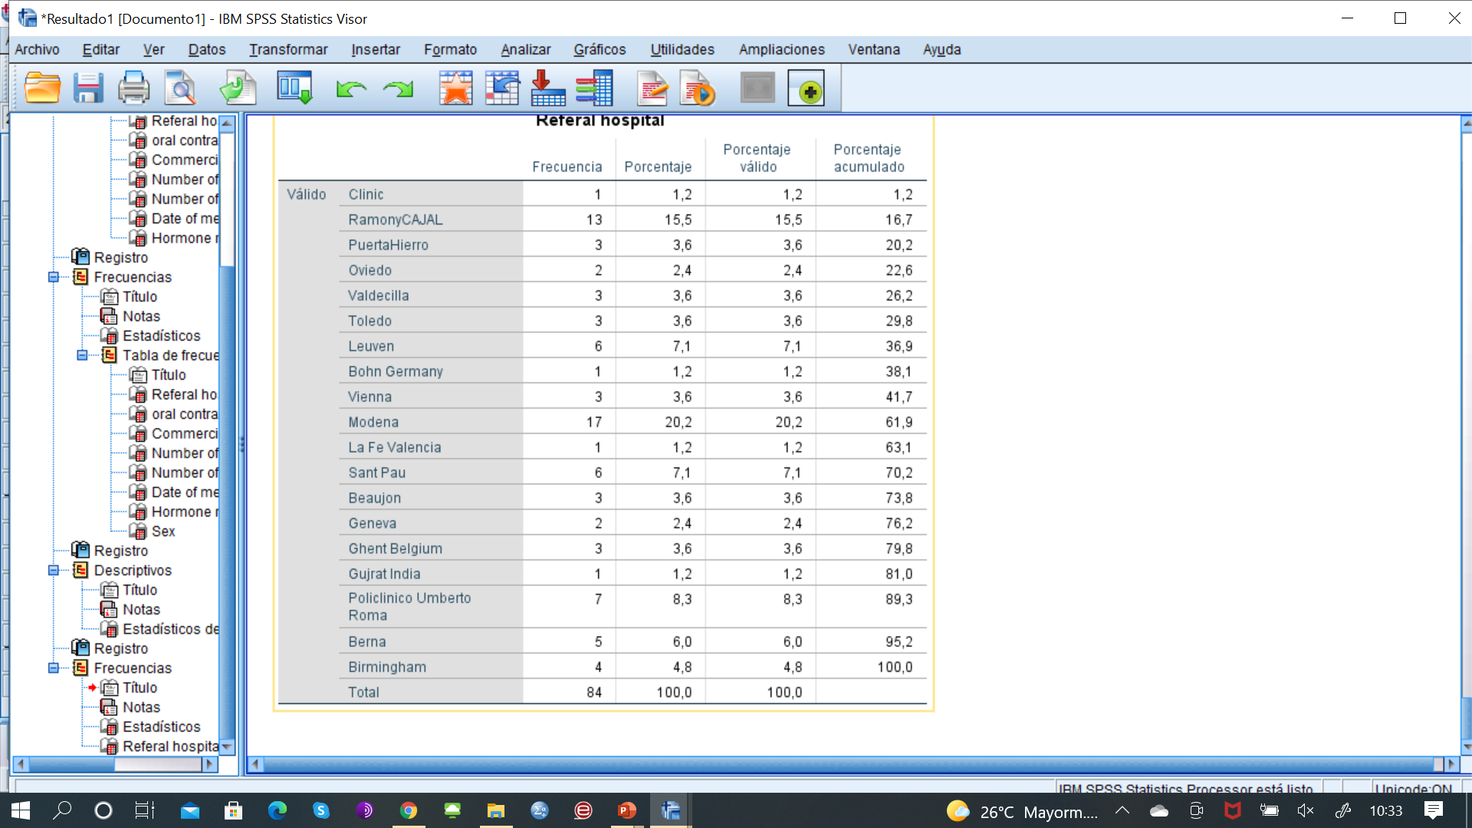
587 patients→ 220 women
Of these it has only been possible to search for information in 84 patients, there is only some information in 42.
Participant centres:
Difficult to collect information!

Slide 19
Abdominal surgery in patients with noncirrhotic EHPVO
Laure Elkrief, Pierre-Emmanuel Rautou
Abdominal surgery may be at high risk in patients wit portal hypertension
No European recent data on the outcome of patients with EHPVO and abdominal surgery
Aim: evaluate the outcome of patients with EHPVO after abdominal surgery (except surgical portosystemic shunt)
  Outcome of patients with EHPVO undergoing abdominal surgery
    Surgical complications (Dindo-Clavien classification)
    Portal hypertension-related complications
    Death within 6 months after surgery
  Compare the outcome of patients with EHPVO to « healthy » controls
  Impact or portal recanalization on the outcome after surgery in patients with EHPVO

Slide 20
Multicenter retrospective case-control study
Cases: patients with EHPVO and abdominal surgery
EHPVO diagnosed prior to surgery
Excluded: cirrhosis (liver biopsy or liver stiffness < 10 kPa)
Controls (2 controls for 1 case): patients without EHPVO in the same center matched for:
  Age (+/- 10 years)
  ASA score
  Type of intervention
 | Cases |  | Controls
Geneva | 6 |  | 12
Lausanne | 4 |  | 8
Hospital Clinic | 18 |  | 36
Val d’Hebron | 4 |  | 8
Madrid | 4 |  | 8
Bonn | 17 |  | 34
Gant | 1 |  | 2
Tours | 10 |  | 20
Lyon | 4 |  | 8
Montpellier | 1 |  | 2
Caen | 6 |  | 12
Beaujon | Collecting data
Total | 75 | 150
Data analysis and end of study in 2022 💪🏻

Slide 21
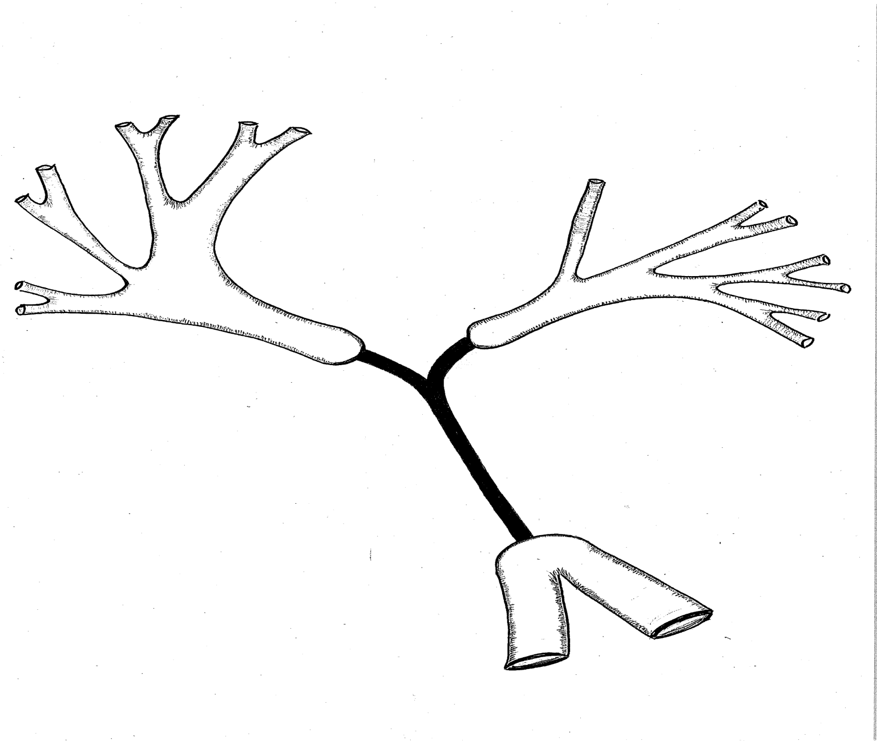
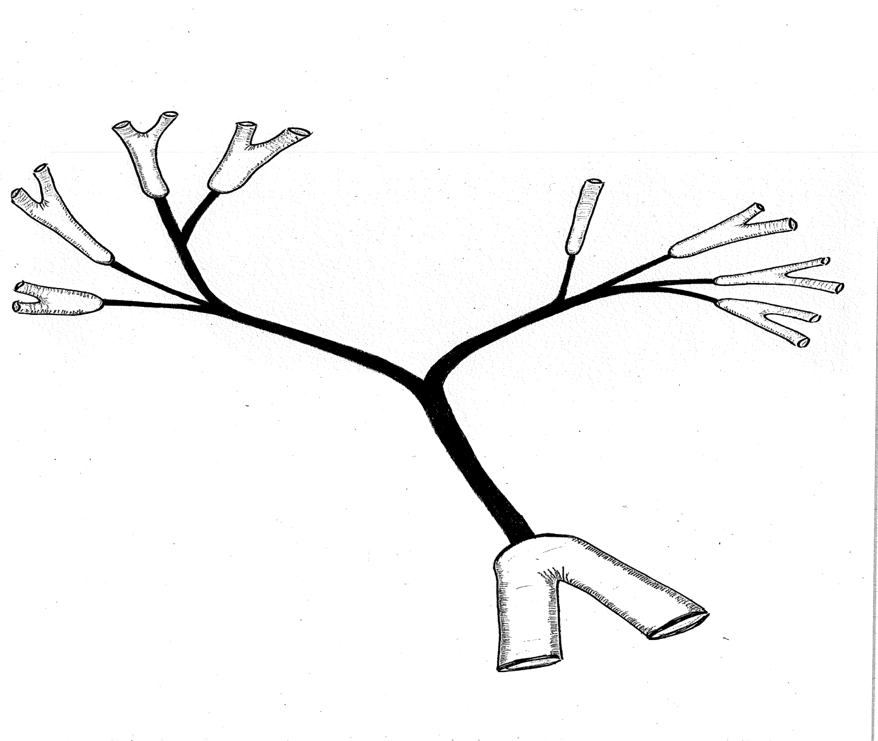
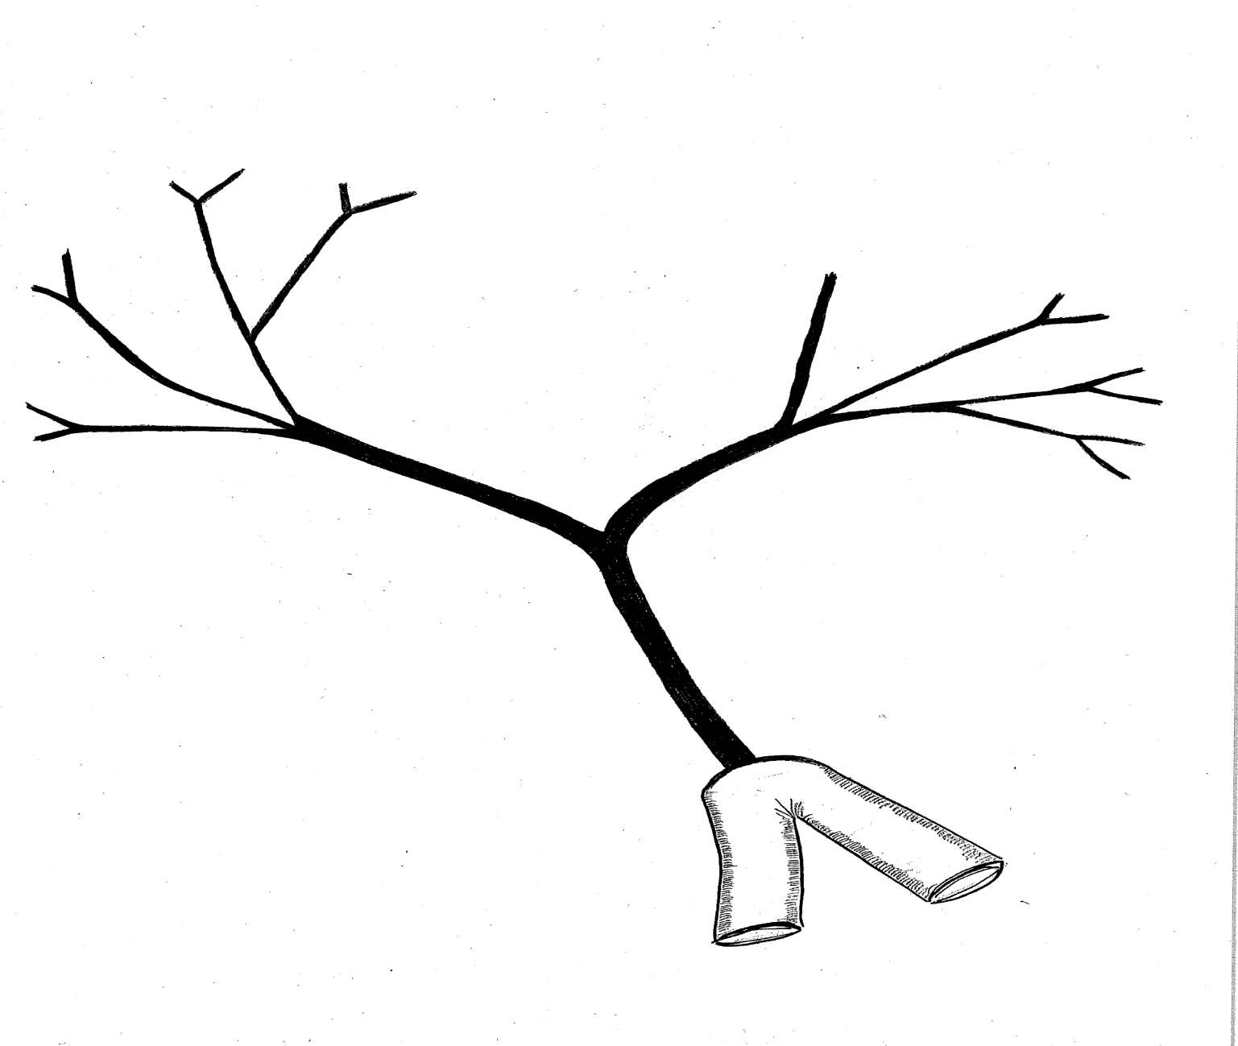
Percutaneous Portal Vein Recanalization using Self-Expandable Nitinol Stents in Patients with Non-cirrhotic Non-tumoral Portal Vein Occlusion
15 non-cirrhotic patients in whom stent placement using a trans-hepatic approach was attempted for the treatment of PVO with cavernous transformation
Type 1 (n=6)
Type 2 (n=7)
Type 3 (n=2)
Occlusion limited to the main portal vein and/or to the right or left portal branches
Occlusion of the main portal vein with extension to segmental branches
Occlusion of the main portal vein with extension to distal branches
Immediate relief of PHT symptoms in all but 1 patient who developed early stent thrombosis
No severe AE
Stent permeability at 2y: 77%
Marot A, et al. Diagnostic and Interventional Imaging 2019;100:147-56

Slide 22
Aims
To validate the usefulness of the classification of PVO according to the vascular extent of PVO to decide when PVR is feasible in a bigger number of patients
To assess the effect of anticoagulation therapy on long-term stent patency
To assess the role of other factors (such as the velocity of the blood within the stent) on long-term stent patency
To assess the benefit of TIPS in addition to PVR
To assess long-term effect of PVR on PHT-related symptoms
To assess long-term evolution of liver function tests
Currently
Lausanne 34 | Beaujon xx patients promised
Boon 21 | Grenoble xx patients promised
Barcelone 11 patients promised | Tours xx patients promised

Slide 23
Splanchnic vein thrombosis in patients with COVID-19 infection
One of the complications which has been described in COVID-19 infection is the increased systemic inflammatory response from the virus which leads to a higher risk of hypercoagulability and associated thromboembolic disease
Splanchnic vein thrombosis occurring outside the setting of cirrhosis is a rare condition which is thought to account for 5% to 10% of all patients with portal hypertension in developed countries
Currently, only a few cases of splanchnic vein thrombosis have been reported in patients with COVID-19
Considering the high risk of thrombotic events in patients with COVID-19 infection, the burden of splanchnic vein thrombosis should be assessed in a large series of patients

Slide 24
Aims
To assess the burden of splanchnic vein thrombosis in patients with COVID-19 infection
To evaluate which splanchnic vein (hepatic, portal, mesenteric, splenic veins) are at risk of thrombosis during COVID-19 infection
To assess the prevalence of other prothrombotic conditions than the hypercoagulable state induced by COVID-19
To assess the impact of splanchnic vein thrombosis on the prognosis of patients with COVID-19 infection
To assess which prognosis factors are associated with poor outcome
To assess the rate of recanalization without or under anticoagulation therapy
Currently
Namur 1 | Beaujon 4
Gent 1 | Lausanne 1
Barcelone 1 (+1 promised) | London 1
Milan 2 | Tours 1

Slide 25

INCIDENCE AND PREDICTIVE FACTORS OF RECURRENT THROMBOSIS
IN NON-CIRRHOTIC PORTAL VEIN THROMBOSIS:
A MULTICENTER OBSERVATIONAL STUDY

Slide 26

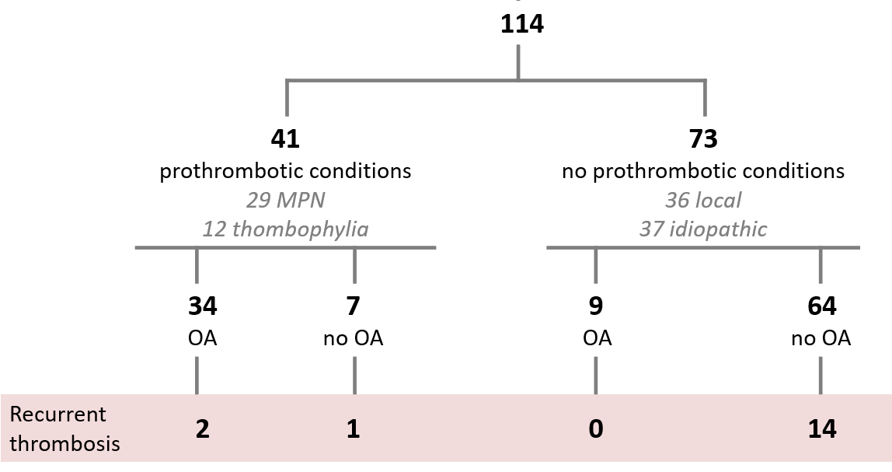
Incidence and predictive factors of recurrent thrombosis in non-cirrhotic PVT
PREVIOUS WORK
Cohort of 114 patients with non – cirrhotic PVT
anticoagulation according to current guidelines
Most rethrombosis events (82%) occurred in patients with idiopathic or local etiology not receiving long-term anticoagulation
3
In this subpopulation,
factor V ≥90% and factor VIII≥150% were associated with rethrombosis
8

Slide 27
Incidence and predictive factors of recurrent thrombosis in non-cirrhotic PVT
CURRENT PLAN
VALIDATION COHORT
Patients with IDIOPATHIC OR ASSOCIATED TO LOCAL FACTOR non – cirrhotic chronic splanchnic vein thrombosis
Not receiving long term anticoagulation
Baseline extension assessment with CT/MRI
Baseline biobank sample available to evaluate Factor V and Factor VIII levels
Periodic imaging test screening for rethrombosis
3
8

Slide 28
Incidence and predictive factors of recurrent thrombosis in non-cirrhotic PVT
CURRENT PLAN. VALIDATION COHORT
Male | 53 (67%)
Etiology Idiopathic Local | 40 (57%) 30 (38%)
Re-thrombosis | 15 (21%)
Asymptomatic re-thrombosis | 8 (53%)
Extrasplanchnic thrombosis | 6 (4%)
Hospital | n
Hospital Clínic de Barcelona | 33
Toulouse | 15
Ramon y Cajal | 14
Cluj | 7
Puerta de Hierro | 1
 | N = 70
3
8
 | No rethrombosis n=55 | Rethrombosis n=15 | p
FV ≥ 90% | 24 | 3 | 0.24
FVIII ≥ 150 | 23 | 11 | 0.03

Slide 29
Long term outcome of patients with Budd-Chiari Syndrome
To assess the long-term outcome of patients with BCS, in order to add more information to the natural history of the disease.
To evaluate the incidence and long-term outcome of interventions in patients with BCS and determined predictive factors on survival and assessment of its timing of implementation.
Establish the best treatment for patients with BCS that initially received a TIPS in whom during follow-up an asymptomatic thrombosis/dysfunction of TIPS occurs.

Slide 30
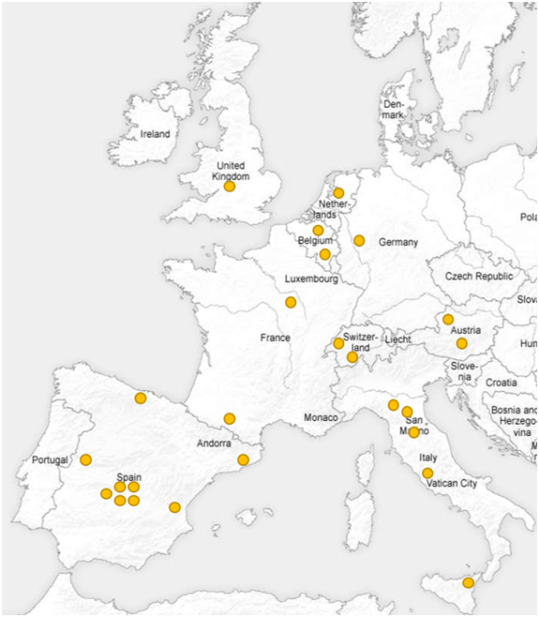
Current status:
Centers that agreed to participate: 23 centers.
Meeting with the participants centers to modify CRF.
ERN approval to use the study´s CFR in the CASTOR platform.
DTA approved and waiting to final to be resend to the participant centers.
CASTOR data base in progress planned to be release final 2021.

Slide 31

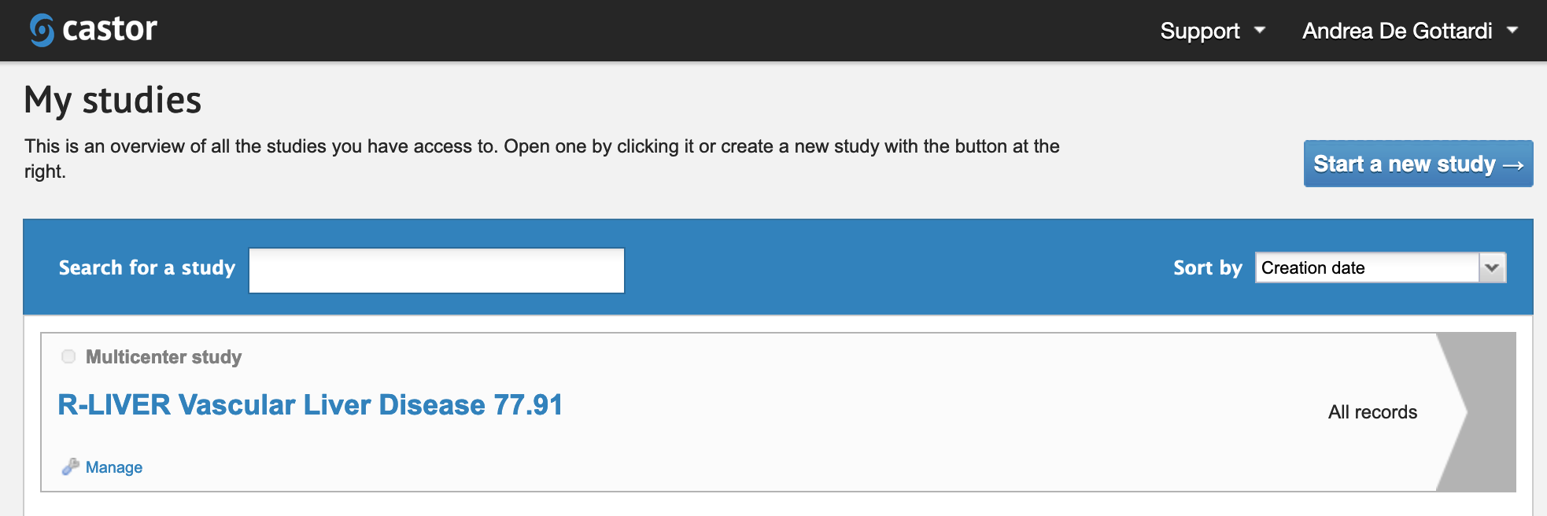
VALDIG Database
Inclusion: Patients with PVT, BCS, PSVD, others
Collaboration with Marcial Sebode at UKE
Adaptation of the documents for the Ethics Committees
Transfer of data
Opening in Castor
Financial support

Slide 32
AGENDA
Welcome and introduction (Andrea De Gottardi)
Steering committee composition (Andrea De Gottardi)
Finances (Pierre-Emmanuel Rautou)
Update preparatory work for BAVENO VII (Pierre-Emmanuel Rautou)
VALDIG publications
Updates about ongoing/planned studies
VALDIG-ERN activities (Aurélie Plessier)
VALDIG training activities and collaboration with EASL (Filipe Nery)
Questions
Closing remarks (Andrea De Gottardi)

Slide 33
ERN rare liver
Management board representative: Aurélie Plessier and Virginia Hernández-Gea
Emmanuel Gonzales hepatologist and pediatrician
Valerie mc Lin

Slide 34
Full Members
San Gerardo Hospital - ASST Monza
Italy
Uniklinik RWTH Aachen
Germany
Universitätsklinikum des Saarlandes, Homburg
Germany
Universitätsklinikum Hamburg-Eppendorf
Germany
Universitätsklinikum Tübingen
Germany
Université Catholique de Louvain (St Luc)
Belgium
University Hospital Ghent
Belgium
University Hospital, Medical University of Warsaw
Poland
University Hospitals KULeuven
Belgium
University Medical Center Groningen
Netherlands
Academic Medical Center Amsterdam
Netherlands
Assistance Publique-Hôpitaux de Paris, Hôpital Beaujon
France
Assistance Publique-Hôpitaux de Paris, Hôpital Bicêtre
France
Assistance Publique-Hôpitaux de Paris, Hôpital Saint-Antoine
France
Azienda Ospedaliera - Universitaria di Padova
Italy
Centro Hospitalar e Universitário de Coimbra, EPE
Portugal
Copenhagen University Hospital Rigshospitalet
Denmark

Slide 35
Full Members
Hospital Clínic de Barcelona
Spain
Hospital Santi Paolo e Carlo - ASST Milan
Italy
•
Hospital Universitario La Paz, Madrid
Spain
•
Karolinska University Hospital, Stockholm
Sweden
•
Medizinische Hochschule Hannover
Germany
•
Radboud University Medical Center Nijmegen
Netherlands
•
Sahlgrenska University Hospital, Gothenburg
Sweden
______
Hospital Clínic de Barcelona
Spain
Hospital Santi Paolo e Carlo - ASST Milan
Italy
Hospital Universitario La Paz, Madrid
Spain
Karolinska University Hospital, Stockholm
Sweden
Medizinische Hochschule Hannover
Germany
Radboud University Medical Center Nijmegen
Netherlands
Sahlgrenska University Hospital, Gothenburg
Sweden

Slide 36
Affiliated Partners
Centre Hospitalier du Luxembourg
Luxembourg
Children`s Clinical University Hospital - Riga
Latvia
Clinical Centre of University of Debrecen
Hungary
Hospital of Lithuanian University of Health Sciences Kauno Klinikos
Lithuania
Mater Dei Hospital - Msida
Malta
Medical University of Vienna
Austria
Oslo University Hospital
Norway
Riga East Clinical University Hospital
Latvia
Tartu University Hospital
Estonia
University Hospital Centre Zagreb
Croatia
University Hospital Dubrava
Croatia
University Medical Center Ljubljana
Slovenia

Slide 37
New call for full members coming soon
  Always possible to ask to be a collaborative partner email ERN Rare Liver <ERN.RareLiver@uke.de>
Working groups from auto immune to rare cancer
  Introduce 2 juniors as leadership and patient’s representative
  Annual workplan and annual meeting mandatory
Clinical exchange programs full members and affiliated partners
  5 days or more visits
  Research mobility fellowship travel 400 euros, accomodation 2000 euros

Slide 38
Valdig/ ERN collaboration
Propose webinars
  PSVD Andrea de Gottardi and Pe rautou
  CPSS Emmanuel Gonzales
Registry valdig to Castor ongoing
  Ethical committee concerns
  Other pediatric registries (Fontan, PSS, mesorex)
Documents on VLD to patients provided by patient’s association
  (pregnancy, BCS, PVT,...)
  translated to be on ERN web site
  Cartoons or new schemes will be performed by ERN
European Joint program :letter of intention accepted
Quality of life of patients living with vascular LIVEr diseaseS
Developing research on the social impact of rare diseases.
6 research partners, 6 patient advocacy organisation,4 collaborators

Slide 39
Identify where guidelines are needed and develop them
Importance of coordination adult-pediatrics: Fontan surgery Full proposal to ERN office/EASL office interdisciplinary team built
6 Women, 7 Men.
Spain: 3 (one is the coordinator)
France: 2
Belgium: 2
The Netherlands: 2
Norway: 1
Denmark: 1
Italy: 1
Germany: 1
UK: 1

Slide 40
Specialized nurses
Involvement in vascular liver diseases presentation at EASL Monothematic conference: Bleeding, Thrombosis, and Vascular Liver Diseases oct 2021
EASL nurse school 2020

Slide 41
AGENDA
Welcome and introduction (Andrea De Gottardi)
Steering committee composition (Andrea De Gottardi)
Finances (Pierre-Emmanuel Rautou)
Update preparatory work for BAVENO VII (Pierre-Emmanuel Rautou)
VALDIG publications
Updates about ongoing/planned studies
VALDIG-ERN activities (Aurélie Plessier)
VALDIG training activities and collaboration with EASL (Filipe Nery)
Questions
Closing remarks (Andrea De Gottardi)

Slide 42
AGENDA
Welcome and introduction (Andrea De Gottardi)
Steering committee composition (Andrea De Gottardi)
Finances (Pierre-Emmanuel Rautou)
Update preparatory work for BAVENO VII (Pierre-Emmanuel Rautou)
VALDIG publications
Updates about ongoing/planned studies
VALDIG-ERN activities (Aurélie Plessier)
VALDIG training activities and collaboration with EASL (Filipe Nery)
Questions
Closing remarks (Andrea De Gottardi)

Slide 43
AGENDA
Welcome and introduction (Andrea De Gottardi)
Steering committee composition (Andrea De Gottardi)
Finances (Pierre-Emmanuel Rautou)
Update preparatory work for BAVENO VII (Pierre-Emmanuel Rautou)
VALDIG publications
Updates about ongoing/planned studies
VALDIG-ERN activities (Aurélie Plessier)
VALDIG training activities and collaboration with EASL (Filipe Nery)
Questions
Closing remarks (Andrea De Gottardi)

Slide 45
Updates about ongoing/planned studies
- Splanchnic vein thrombosis and/or Budd-Chiari Syndrome after SARS-COV-2 vaccination (Darwish Murad)
- COVID-19 Vaccine Efficacy and Safety in patients with Vascular Liver Disease (Hernandez Gea)
- Splanchnic vein thrombosis in patients with COVID-19 infection (Deltenre, Plessier)
- International Registry of Congenital Porto-Systemic Shunts (IRCPSS) (Korff)
- Abdominal surgery in patients with chronic extra-hepatic portal vein obstruction (Elkrief)
- Long-term outcome of patients with Budd-Chiari Syndrome (Perez Campuzano)
- Incidence and predictive factors of recurrent thrombosis in non-cirrhotic portal vein thrombosis. VALIDATION COHORT. (Baiges)
- Percutaneous Portal Vein Recanalization using Self-Expandable Nitinol Stents in Patients with Non-cirrhotic Non-tumoral Portal Vein Occlusion (Deltenre)
- Development of portal hypertension after acute portal vein thrombosis. A long-term follow-up study (Betancourt)
- Menopause, female hormones and PSVD (Magaz)
- Natural history of Portosinusoidal Vascular Disease (PSVD) and Liver Transplantation (Magaz)
- Medically assisted reproduction in women with vascular liver diseases (Payancé)
- VALDIG Database (De Gottardi)

